Slide 1


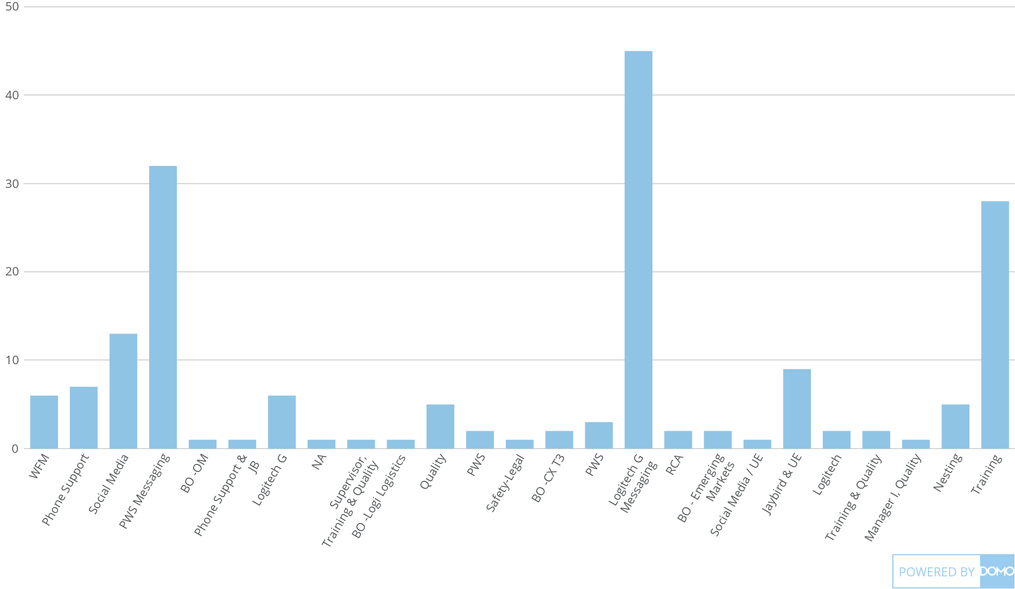
+
exported Apr 6, 2025, 12:55:00 AM MDT
Active Employee.xlsx
179 Count of Role

